Slide 1

CHICAGO CRIME ANALYSIS
Aayusha Shrestha Bishwas Kafle Suman Astani

Slide 2
OUTLINE
Introduction
Objectives
Dataset
Approaches
Models Used
Result and Evaluation
Conclusion
Limitations
Future Work

Slide 3


INTRODUCTION
Crime is a social problem.
Law enforcement agencies in Chicago have been facing problems in addressing high crime rate.
Machine learning has emerged as a valuable tool for predicting and arrest decisions.
We will explore the opportunities and challenges of using ML in predicting arrest decisions

Slide 4
OBJECTIVES
Build machine learning models capable of predicting whether a person will be arrested or not.
Evaluate and compare the performances of different data mining algorithms in terms of their predictive accuracy, sensitivity, specificity
Identify the opportunities and challenges for predicting arrests, including issues related to data quality, feature selection, model interpretabiltiy.

Slide 5
DATASET
Dataset collected from Chicago Data Portal which is publicly available from 2001 to Present.
22 variables present in the dataset.
Contains information such as Date, Crime Type, Description, Location, Arrest, Community Area, Beat, Domestic etc
‘Arrest’ is the response variable.

Slide 6
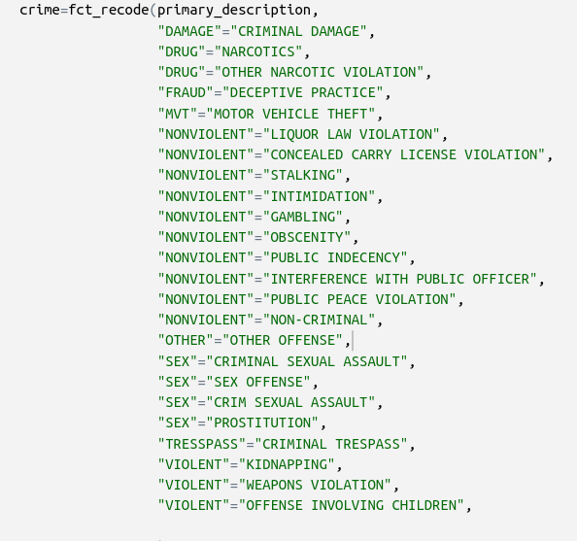
APPROACHES
Data Cleaning and Preprocessing
Dropped null/missing values.
Filtered out irrelevant features
Variable Date has been segregated into Day, Month and Weekday variables
Combined similar crime type into one to reduce the number.

Slide 7
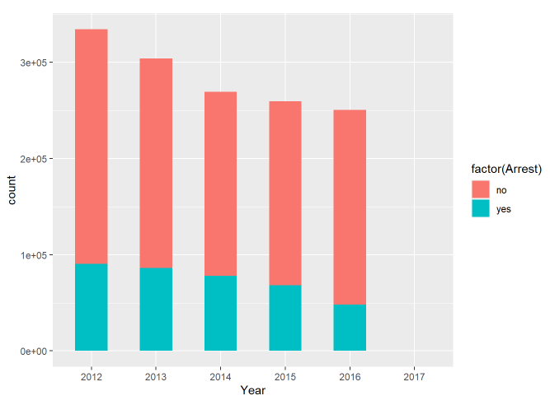
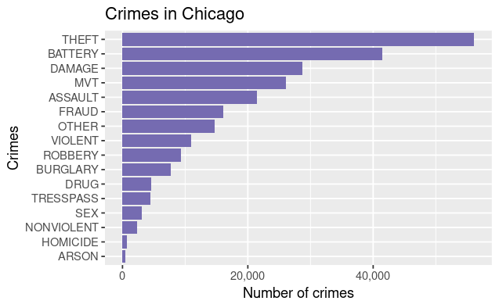
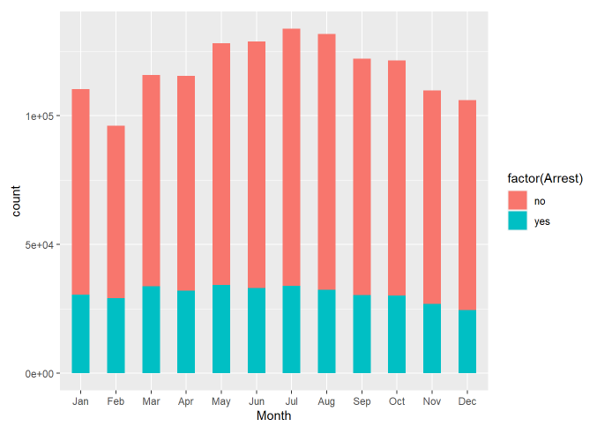
EXPLORATORY ANALYSIS
Arrest Decision based on Year and Month respectively.
Non Arrest rate is always higher compared to arrest for each year and month.
Theft and Battery most frequent crime, ARSON with least.

Slide 8
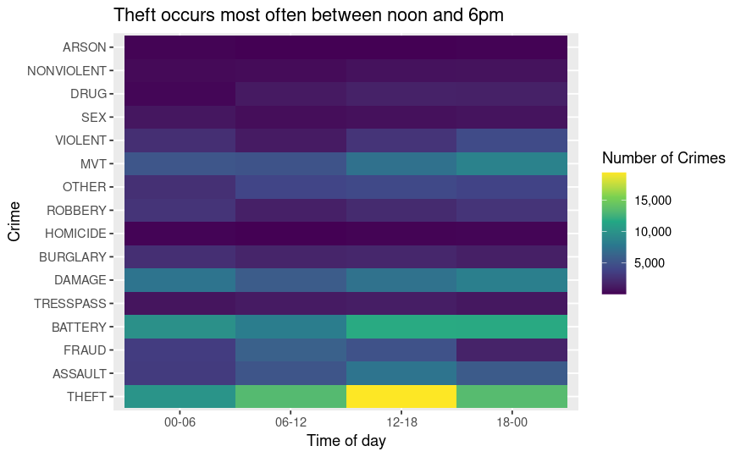
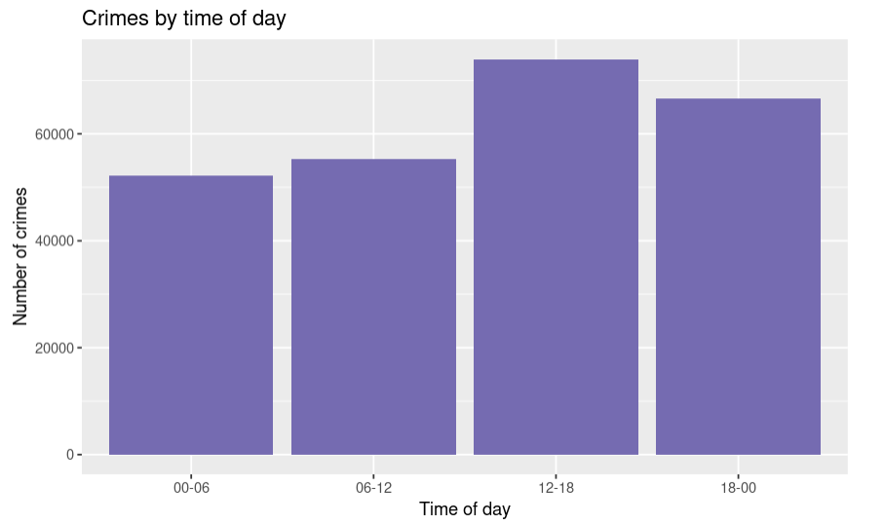
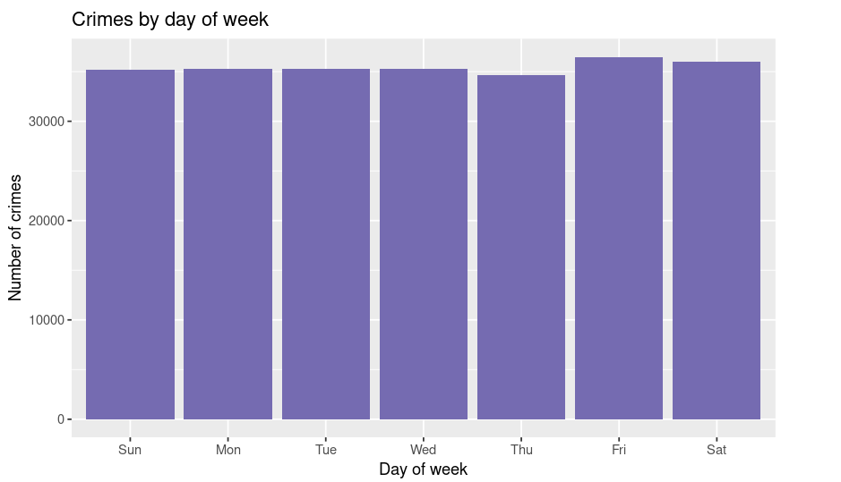
EXPLORATORY ANALYSIS
Friday highest no of crime. midday is the time where criminal are most active. Recorded crime is maximum.

Slide 9
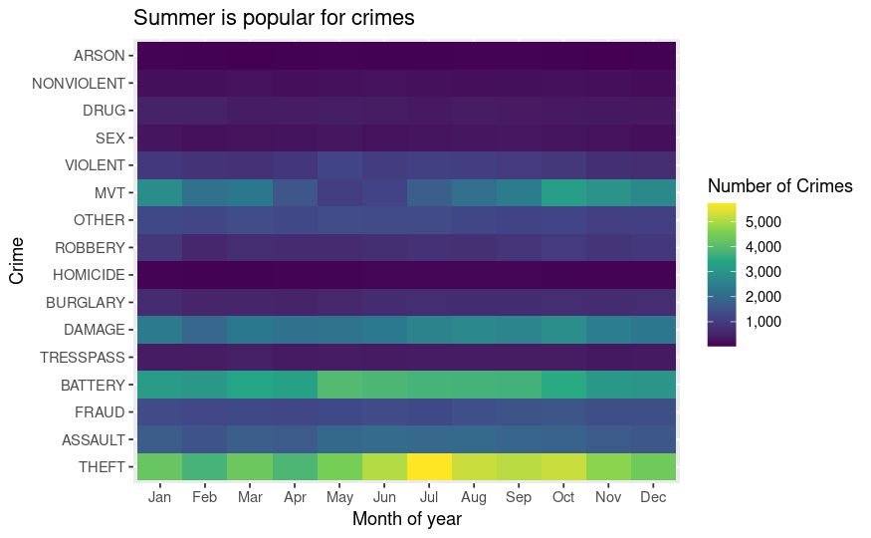
EXPLORATORY ANALYSIS
Summer popular time for crime.
May to August => High Crime Reason? Weather condition, Peak tourism, Economic factor [ i,e summer month] people earn and travel a lot

Slide 10
MODELS USED
K-Nearest Neighbors
Decision Trees

Slide 11
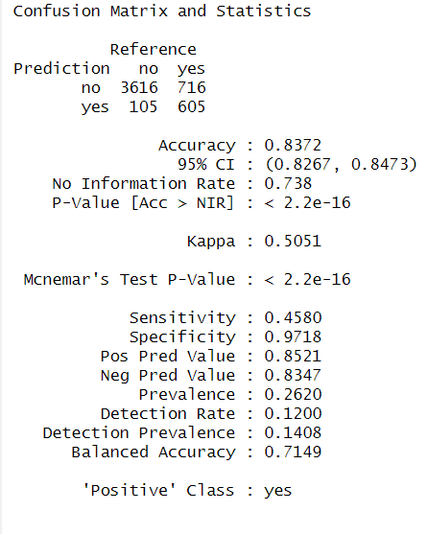
Confusion Matrix for KNN

Slide 12
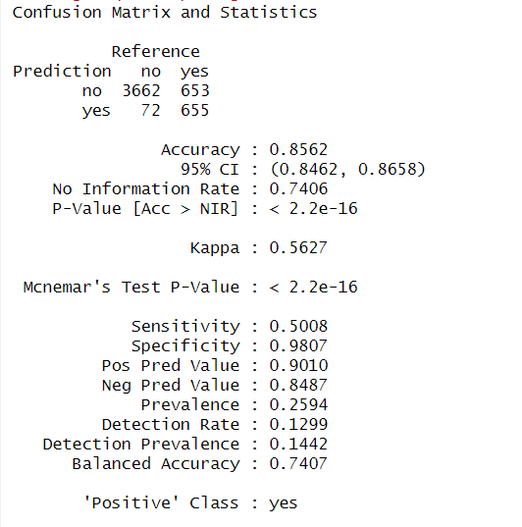
Confusion Matrix For Decision Tree

Slide 13
RESULT AND EVALUATION
MODEL | ACCURACY | KAPPA | SENSITIVITY | SPECIFICITY
KNN | 0.8372 | 0.5051 | 0.4580 | 0.9718
Decision Tree | 0.8562 | 0.5627 | 0.5008 | 0.9807

Slide 14
CONCLUSION
Both models performed well in predicting the arrest decision and have shown promising result with decision tree showing better results
Further research and refinement can lead to improved accuracy of these models

Slide 15
LIMITATIONS
Data Quality
Imbalanced Data

Slide 16
FUTURE WORK
Using additional models such as Neural Network, Random Forest.
Feature Engineering
Fairness and bias mitigation
Real-time Prediction
Crime hotspot prediction
Criminal Network Analysis

Slide 17
THANK YOU !!!

